Slide 1
Verolog: Basics
Installation, Syntax, and Examples

Slide 2
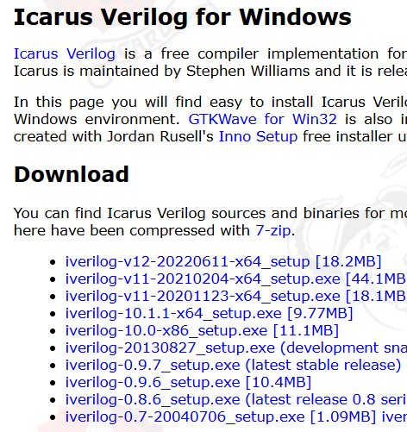
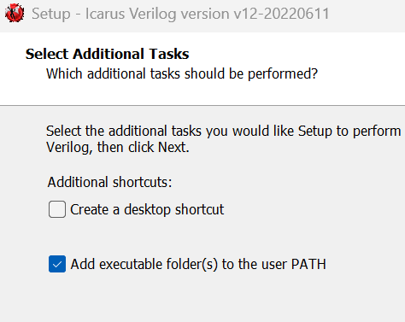
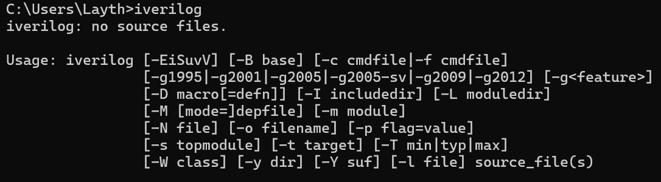
Installing/Setting Up: Icarus Verilog
Install and run iverilog-v12.exe from the Icarus Verilog website
Accept all till ‘Additional Tasks’, select ‘Add executable folder(s) to user PATH’
Verify installation by opening the ‘Command Prompt’, and writing ‘iverilog’ and running, you should see the following

Slide 3
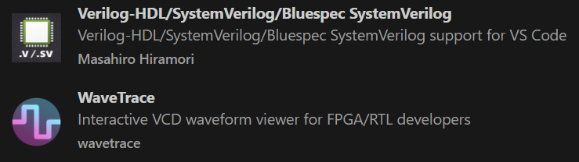
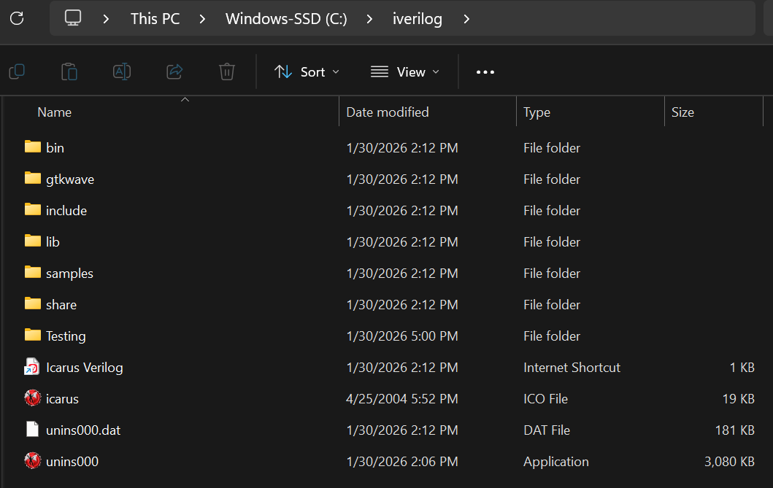
Installing/Setting Up: Visual Studio Code
Install the following VSCode extensions
Make a folder in your ‘iverilog’ folder to store files
You can compile files by opening up a new terminal and typing the following, iverilog -o <filename>.vvp <filename>.v
You can run files by typing, vvp <filename>.vvp, into the terminal

Slide 4
Syntax: Lexical Element
// any text | One line comments start with // and end at the end of the line
/* this is all text Even this */ | Multi-line comments start with /* and end with */
Additional Information

Slide 5
Syntax: Integer Literals
2’b10 - 2 | Binary literal
2’O27 - 23 | Octal literal
9 or ‘d9 - 9 | Decimal literal
3’h1A5 - 421 | Hexadecimal literal
Additional Information

Slide 6
Syntax: Registers and Nets
reg [5:0] din; reg [15:0] mem16X512 [0:511]; // 16-bit, 512 rows // mem16X512[4] addresses word 4 | A 6-bit vector register: individual bits din[5],.... din[0]. A register stores its value from one assignment to the next and is used to model data storage elements.
wire net1; /* The default range of a wire or reg is one bit */ | Nets correspond to physical wires that connect instances. Nets do not store values and have to be continuously driven.
Additional Information

Slide 7
Syntax: Compiler Directives
‘define OPCODEADD 00010 | Text-macro substitution
`include <Verilog file> | File inclusion
‘timescale 1ns / 10ps | Specifies time unit/precision
`ifdef SYNTH <Verilog Code> ‘endif | Text-macro substitution with code
Additional Information

Slide 8
Syntax: System Tasks and Functions
$display, $write | Utility to display information
$fdisplay, $fwrite | Write to file
$monitor, $fmonitor | Monitor, display/write information to file
$finish, $Stop | Exit the simulator, Stop the simulator
Additional Information

Slide 9
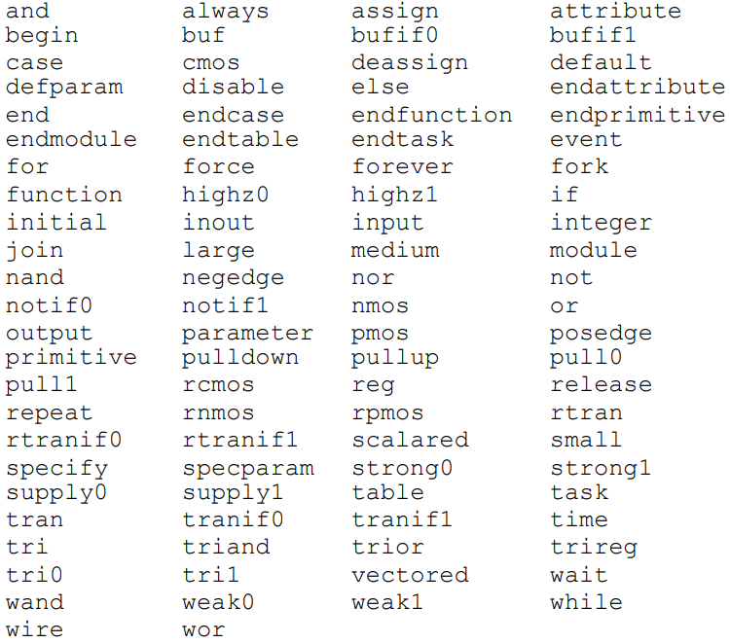
Syntax: Reserved Keywords
Additional Information

Slide 10
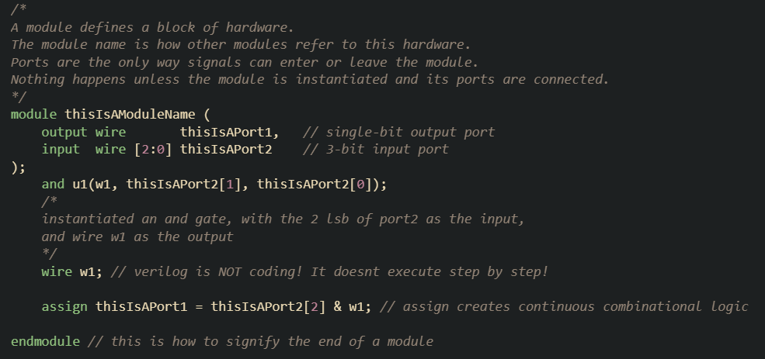
Example: Logic Module
Online Compiler

Slide 11
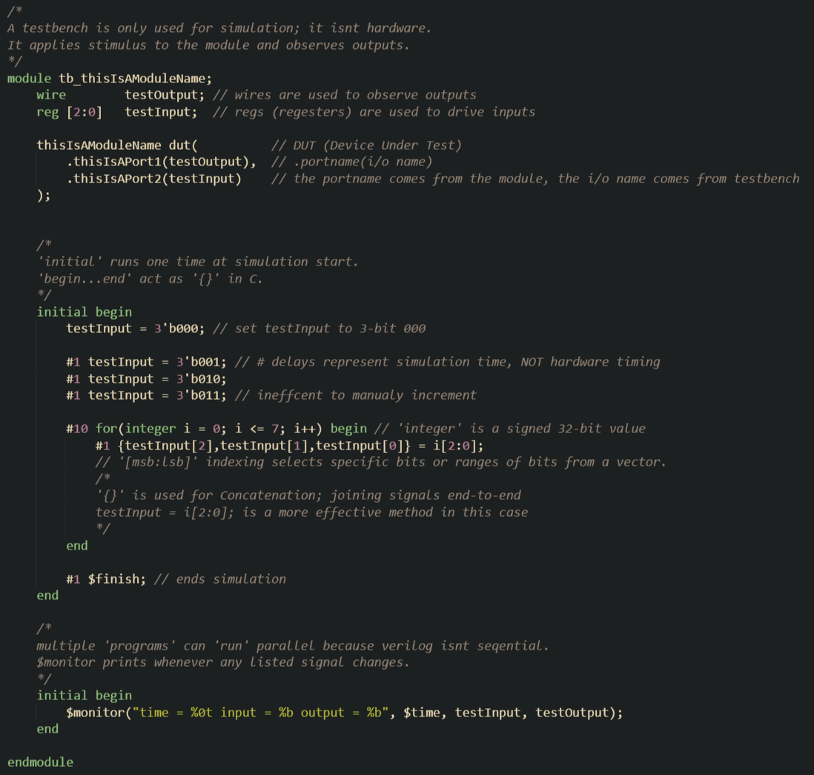
Example: Testbench Module
Online Compiler

Slide 12
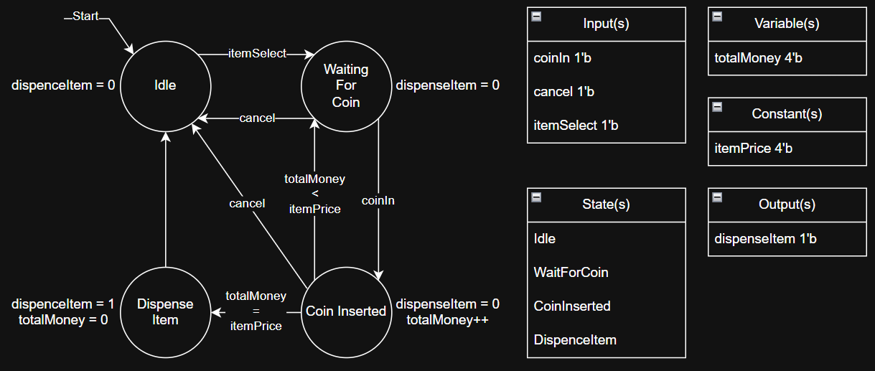
Example: State Machine
Diagram Maker

Slide 13
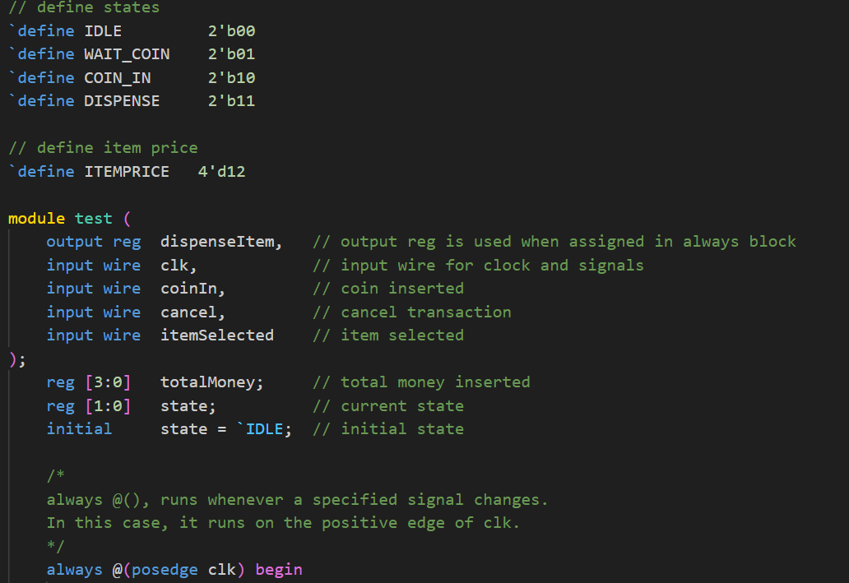
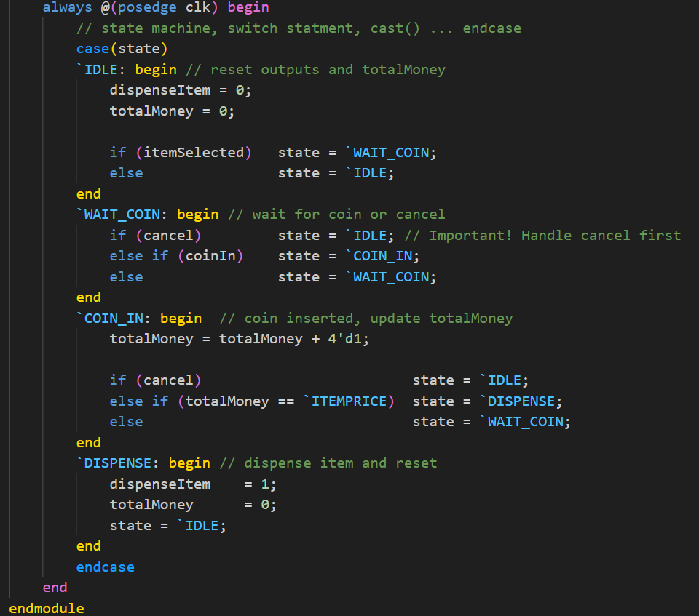
Example: State Machine Module
Online Compiler

